Slide 1

BEYOND WORD IMPORTANCE: CONTEXTUAL DECOMPOSITION
TO EXTRACT INTERACTIONS FROM LSTMS
-W. James Murdoch, Peter J. Liu, Bin Yu
January 24, 2020
Presenter: Rishab Bamrara
https://qdata.github.io/deep2Read/

Slide 2
Motivation
LSTMs are successful because of their ability to learn complex and non-linear relationships. However, we are unable to describe the learned relationships of LSTMs which has led to LSTMs being characterized as black boxes.
Notes:
The motivation of this project

Slide 3
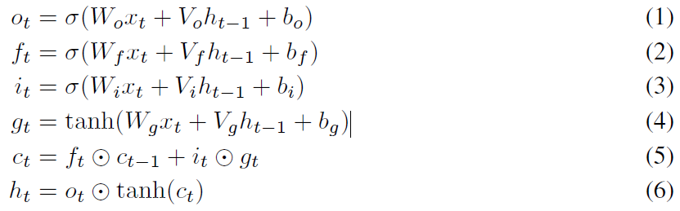
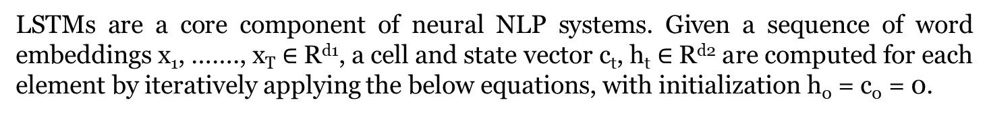
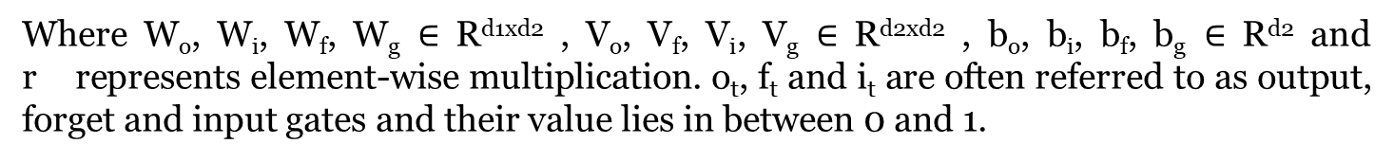
Background
LSTMs are a core component of neural NLP systems. Given a sequence of word embeddings x₁, ……., x_{T} $∈$ R^{d1}, a cell and state vector c_{t}, h_{t} $∈$ R^{d2} are computed for each element by iteratively applying the below equations, with initialization h₀ = c₀ = 0.
Where W_{o}, W_{i}, W_{f}, W_{g} $∈$ R^{d1xd2} , V_{o}, V_{f}, V_{i}, V_{g} $∈$ R^{d2xd2} , b_{o}, b_{i}, b_{f}, b_{g} $∈$ R^{d2} and r represents element-wise multiplication. o_{t}, f_{t} and i_{t} are often referred to as output, forget and input gates and their value lies in between 0 and 1.

Slide 4
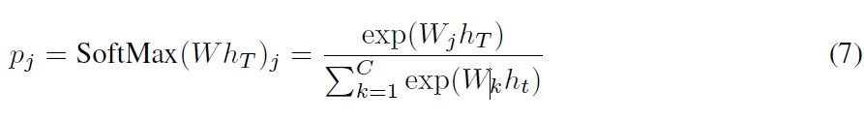
Background (Contd.)
After processing the full sequence, the final state h_{T} is treated as a vector of learned features, and used as an input to SoftMax logistic regression, to return a probability distribution p over C classes, with:

Slide 5
Related Work
Mostly the previous work on interpreting LSTMs has focused on approaches for computing word-level importance scores, with varying evaluation protocols.
Murdoch & Szlam (2017): Cell Decomposition.
Li et al. (2016): Leave One Out.
Sundararajan et al. (2017): Integrated Gradients.
Karpathy et al. (2015), Strobelt et al. (2016): Analysing gate activations.
Bach et al. (2015), Shrikumar et al. (2017): Applied Decomposition-based approaches to CNNs.
Bahdanau et al. (2014): Attention based models.

Slide 6
Claim / Target Task
Without changing the underlying model of LSTM and decomposing it’s output, CD (Contextual Decomposition) captures the contributions of combinations of words or variables to the final prediction of LSTM.
Notes:
Here, we make the claim of this project.

Slide 7
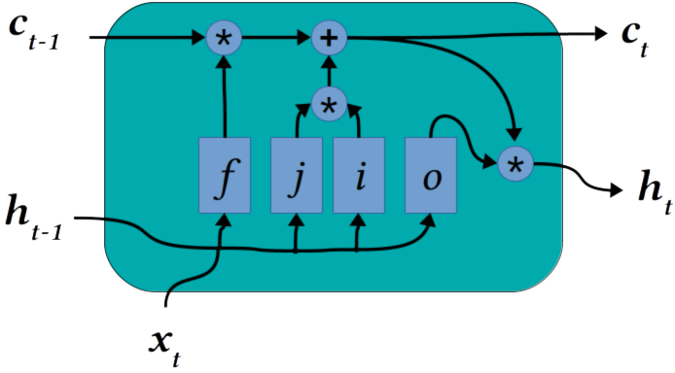
An Intuitive Figure Showing WHY Claim
β_{c}
γ_{c}
β_{t}
γ_{t}
LSTM
https://blog.exxactcorp.com/5-types-lstm-recurrent-neural-network/
Notes:
Here, we make the claim of this project.

Slide 8
Proposed Solution
Given an arbitrary phrase x_{q}, ….., x_{r}, where 1<= q <= r <= T, decompose each output and cell state c_{t}, h_{t} in equations 5 and 6 (above) into a sum of two contributions:
h_{t} = β_{t} + γ_{t}
c_{t} = β_{c} + γ_{c}
β_{t} corresponds to contributions made solely by the given phrase to h_{t}, and
γ_{t} corresponds to contributions involving, at least in part, elements outside of the phrase.
β_{c} & γ_{c} are analogous to c_{t}.
Using the above decomposition, the final output state Wh_{T} is given as:
p = SoftMax(Wβ_{t} + Wγ_{t})
Here, Wβ_{t} provides a Quantative score for the phrase’s contribution to the LSTM’s prediction.
Notes:
Here is our proposed solution.

Slide 9
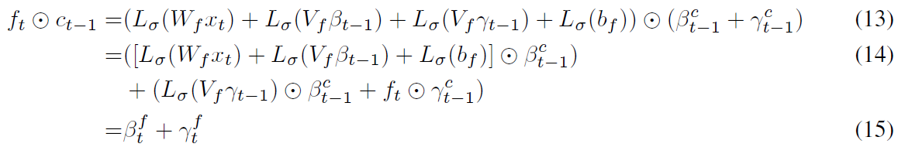
Implementation
Authors assume that they have a way of linearizing tanh and sigmoid gates and updates in equations 2, 3, 4.
Once, we can do this then we can also linearize the element-wise inner product and hence find linearization for h_{t} and c_{t}.
Notes:
In the rest of this presentation, I’m going to talk about following contents:

Slide 10
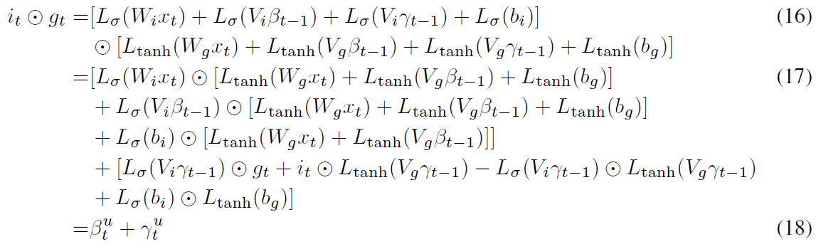
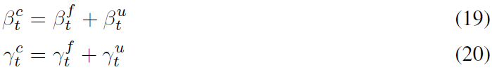
Implementation (Contd.)
Now the decomposition of c_{t} can be found by summing the two contributions:
Notes:
In the rest of this presentation, I’m going to talk about following contents:

Slide 11
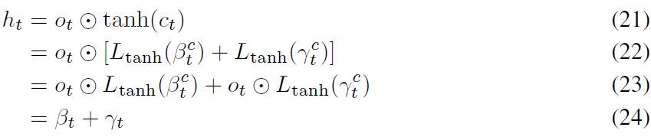
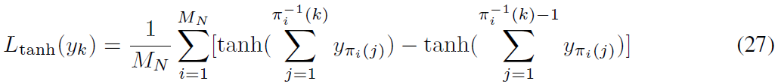
Implementation (Contd.)
Once decomposition of c_{t} is computed, resulting transformation of h_{t} is given by:
Linearization of tanh gate is also provided in the paper:
Where, π₁, …., π_{MN} denote the set of all permutations of 1, ….., N variables inside the tanh gate excluding the bias term.
Notes:
In the rest of this presentation, I’m going to talk about following contents:

Slide 12
Data Summary
Stanford Sentiment Treebank (SST): Standard NLP benchmark which consists of movie reviews ranging from 2 to 52 words long. In addition to labels of reviews, it also has labels for each phrase in the review.
Yelp Polarity: This was obtained from the Yelp Dataset Challenge. It has train and test sets of sizes 560,000 ad 38,000 respectively. Average length of review is 160.1 words. It contains only review labels.
Notes:
In the rest of this presentation, I’m going to talk about following contents:

Slide 13
Experimental Results and Analysis
Model | SST (Accuracy) | Yelp (Error)
LSTM | 87.2% | 4.6%
Logistic Regression | 83.2% | 5.7%
Above results indicate that both LSTM and Logistic Regression perform well on SST as well as Yelp dataset.
Attribution Method | SST (Unigram scores) | Yelp (Error)
CD | 0.76 | 0.52
Integrated Gradients | 0.72 | 0.34 – 0.56
Other Methods | <=0.51 | 0.34 – 0.56
For SST, both CD and Integrated Gradients performs better out of all the other methods. On Yelp, although the gap is not very big, but CD is still very competitive and is closer to the best result. Overall, CD gives strong results.
Notes:
In the rest of this presentation, I’m going to talk about following contents:

Slide 14
Experimental Results and Analysis (Contd.)
Attribution Method | Kolmogorov-Smirnov one-sided test statistic
CD | 0.74
Cell Decomposition | 0
Integrated Gradients | 0.33
Leave One out | 0.58
Gradient | 0.61
Kolmogorov-Smirnov one-sided test statistic is a common test for the difference of distributions with values ranging from 0 to 1. Larger the value means the method is able to identify strong difference between positive and negative distributions. As can be seen, CD outperforms all the other methods.
Notes:
In the rest of this presentation, I’m going to talk about following contents:

Slide 15
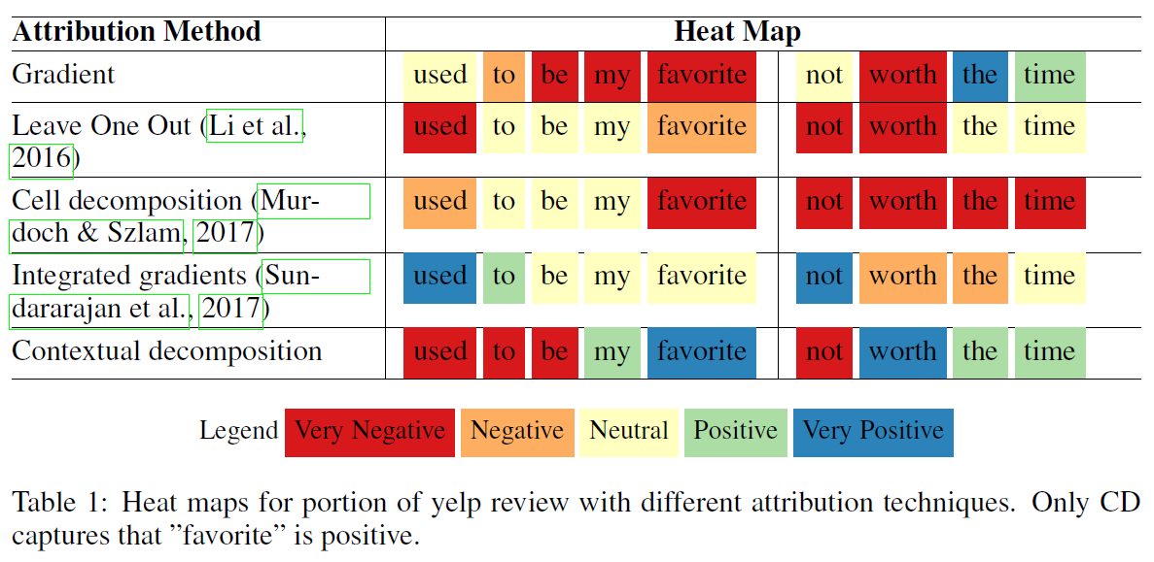
Experimental Results and Analysis (Contd.)
Notes:
In the rest of this presentation, I’m going to talk about following contents:

Slide 16
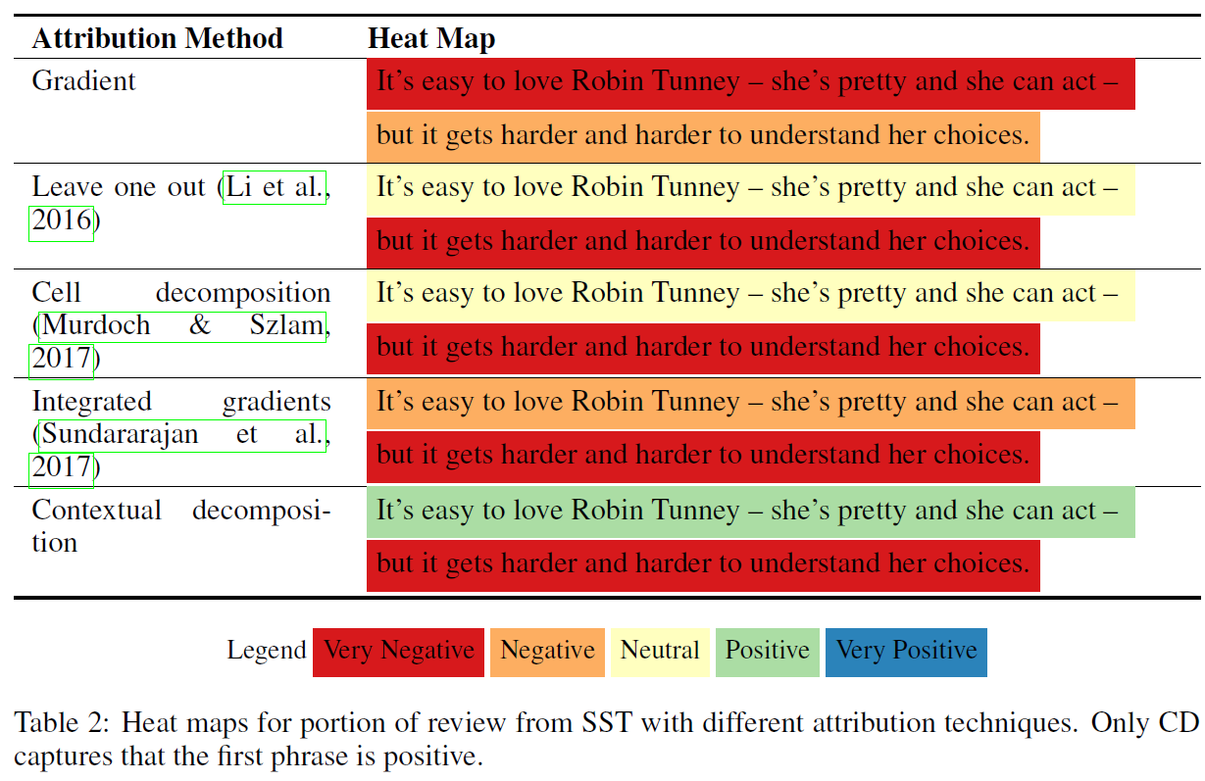
Experimental Results and Analysis (Contd.)
Notes:
In the rest of this presentation, I’m going to talk about following contents:

Slide 17
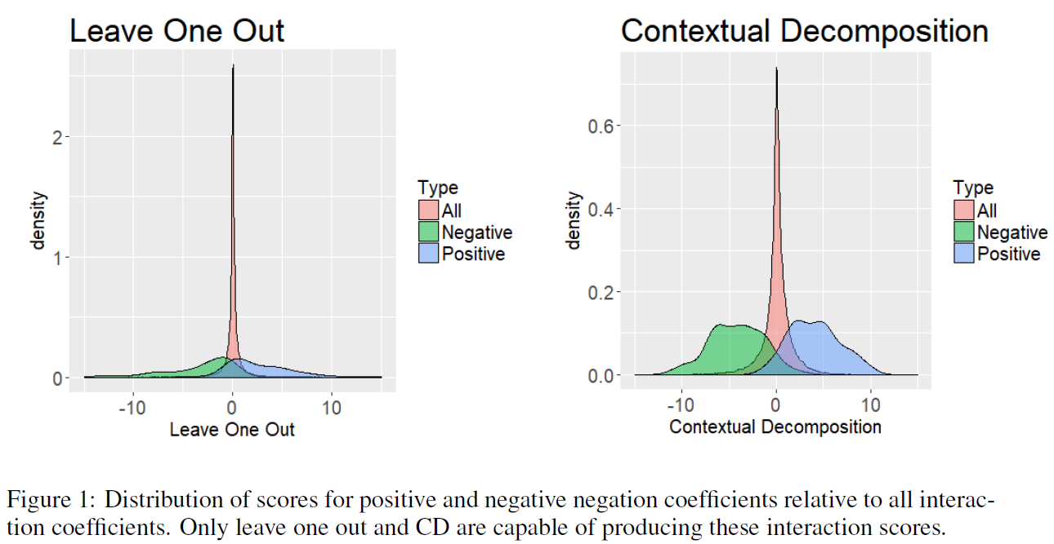
Experimental Results and Analysis (Contd.)
Notes:
In the rest of this presentation, I’m going to talk about following contents:

Slide 18
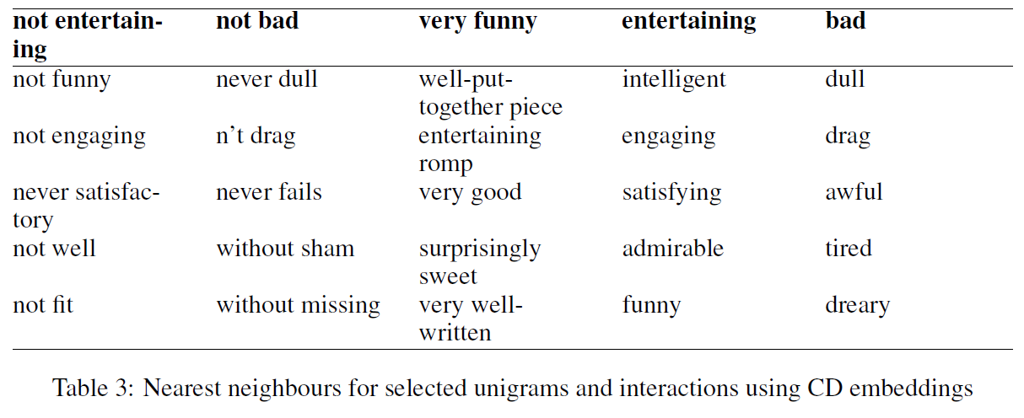
Experimental Results and Analysis (Contd.)
Notes:
In the rest of this presentation, I’m going to talk about following contents:

Slide 19
Conclusion and Future Work
Proposed contextual decomposition (CD) algorithm is able to interpret predictions made by LSTMs without modifying the underlying model. In both NLP and general applications of LSTMs, CD produces importance scores for words, phrases and word interaction. CD also performs well in comparison with the other methods. Also, CD is capable of identifying phrases of varying sentiment and extracting meaningful word interactions.

Slide 20
References
Sebastian Bach, Alexander Binder, Gr´egoire Montavon, Frederick Klauschen, Klaus Robert M¨uller, and Wojciech Samek. On pixel-wise explanations for non-linear classifier decisions by layer-wise relevance propagation. PloS one, 10(7):e0130140, 2015.
Dzmitry Bahdanau, Kyunghyun Cho, and Yoshua Bengio. Neural machine translation by jointly learning to align and translate. arXiv preprint arXiv:1409.0473, 2014.
W James Murdoch and Arthur Szlam. Automatic rule extraction from long short term memory networks. ICLR, 2017.
Jiwei Li, Will Monroe, and Dan Jurafsky. Understanding neural networks through representation erasure. CoRR, abs/1612.08220, 2016. URL http://arxiv.org/abs/1612.08220.
Mukund Sundararajan, Ankur Taly, and Qiqi Yan. Axiomatic attribution for deep networks. CoRR, abs/1703.01365, 2017. URL http://arxiv.org/abs/1703.01365.
Andrej Karpathy, Justin Johnson, and Li Fei-Fei. Visualizing and understanding recurrent networks. arXiv preprint arXiv:1506.02078, 2015.

